Slide 1
Non-equilibrium electron dynamics from real-time quantum embedding
Joshua Kretchmer
Georgia Institute of Technology
Division of Chemistry and Biochemistry

Slide 2
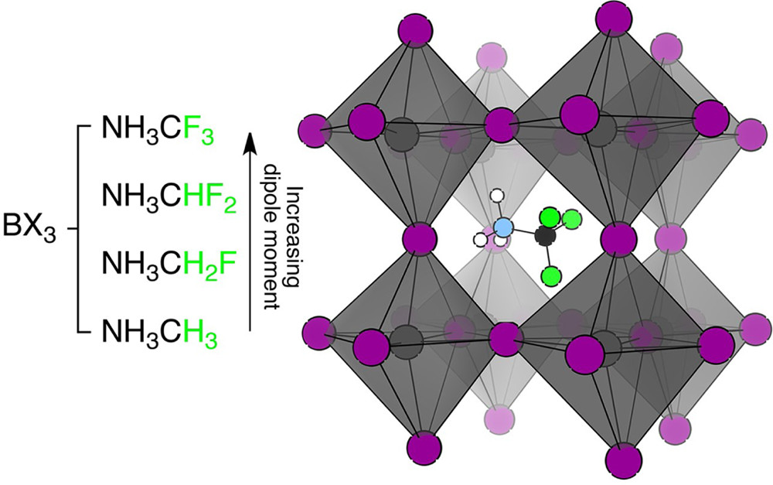
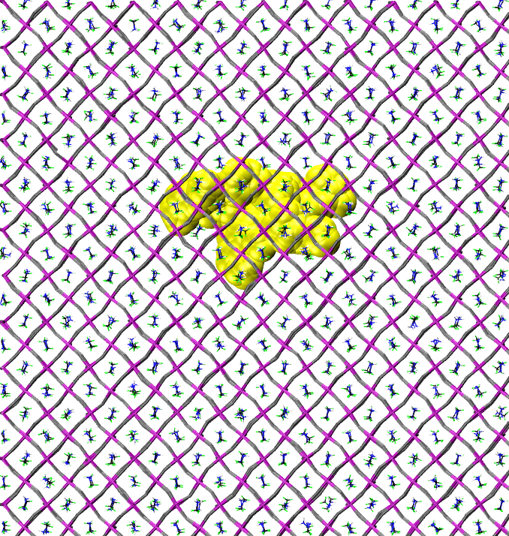
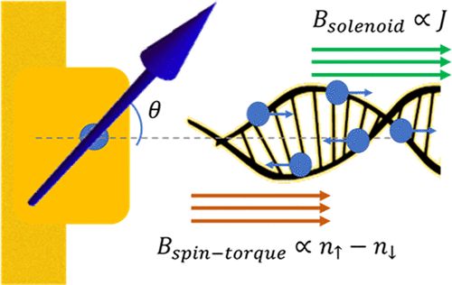
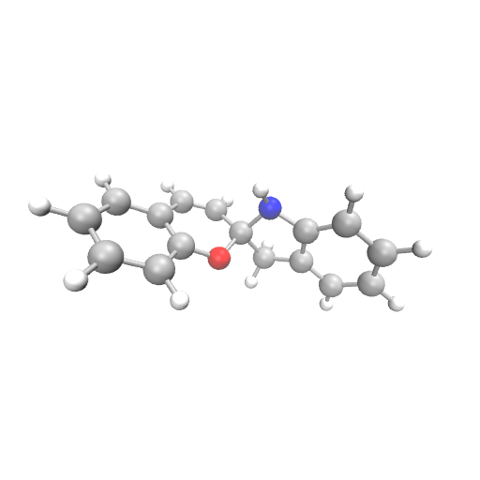
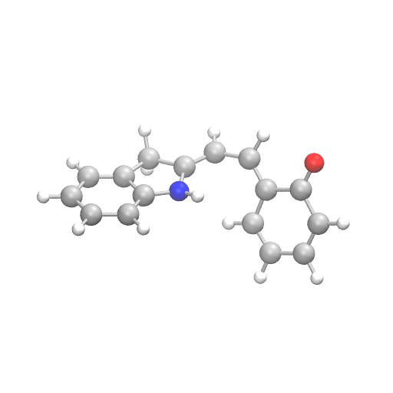
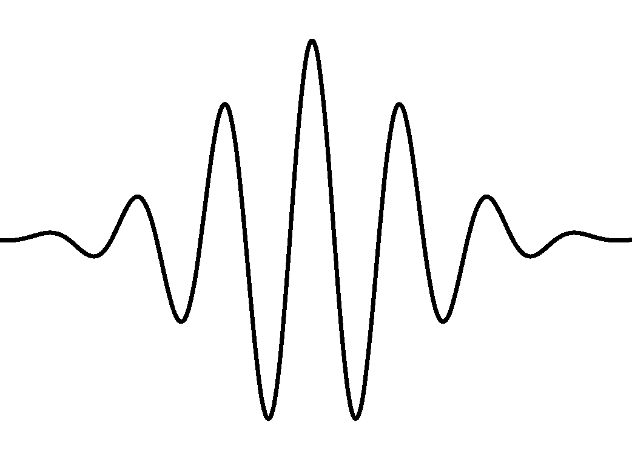
Kretchmer Group: New simulation methods for
electron dynamics in complex environments
Method Development Development
Transport Dynamics in Correlated Materials
Multi-faceted research group working at the interface of electronic structure and quantum dynamics
Examine electron-nuclear, electron-electron, and spin-spin interactions in governing the non-equilibrium transport of electrons
Classically Isomorphic Methods
Real-Time Electronic Structure
Charge-transport in perovskites
Spin-transport across interfaces
Map a complicated quantum system to a computationally tractable classical system
Solve the time dependent Schrödinger equation – Quantum embedding
Subsystem coupled to large environment
+
Magnetic tunnel junctions
Chirality-induced spin selectivity
Quantum mechanics
Classical mechanics
Subsystem coupled to small environment
Explicit electron in fully atomistic simulation
Chemical Dynamics in Optical Cavities
Electron Dynamics in Weakly Bound Systems
Investigate the influence of quantum light on chemical dynamics
Ionization of a core electron initiates competing ultrafast electronic processes that lead to fragmentation in VdW and H-bonded systems
Interatomic Coulomb Decay
ET Mediated Decay
+
ICD
?
ETMD
Strong coupling between a molecular system and quantized modes of light can modify the energy landscape
High-temperature Bose-Einstein condensates as a “quantum solvent” to modify chemistry based on charge-transfer
+
A
B
A
B
+
+
+

Slide 3
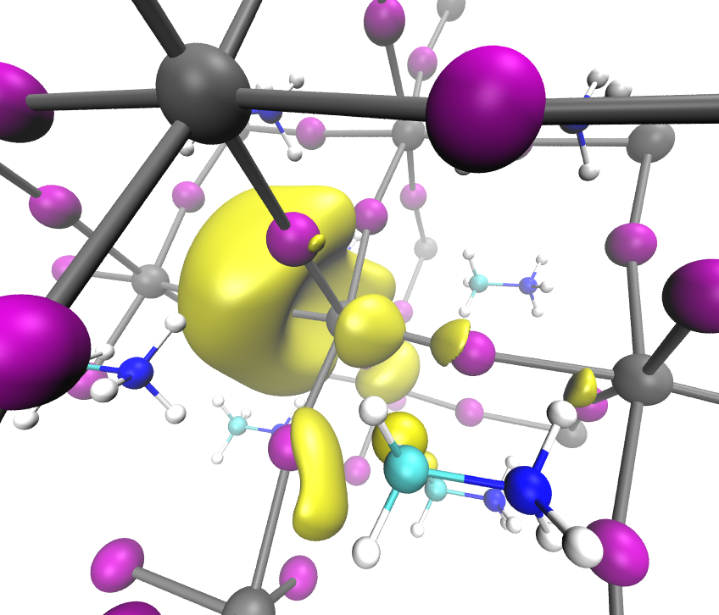
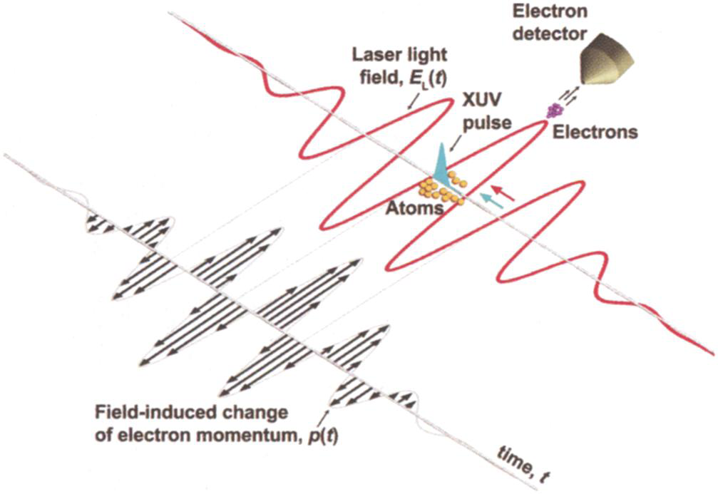
Non-Equilibrium Electron Dynamics
Photoexcited Materials
Spin Dynamics and Selectivity
Laser Driven Electron Dynamics
Electronic motion even in the absence of nuclear motion

Slide 4
Non-Equilibrium Electron Dynamics
Photoexcited Materials
Spin Dynamics and Selectivity
Laser Driven Electron Dynamics
Develop efficient and accurate method for the direct simulation of the electronic wavefunction in strongly correlated systems

Slide 5
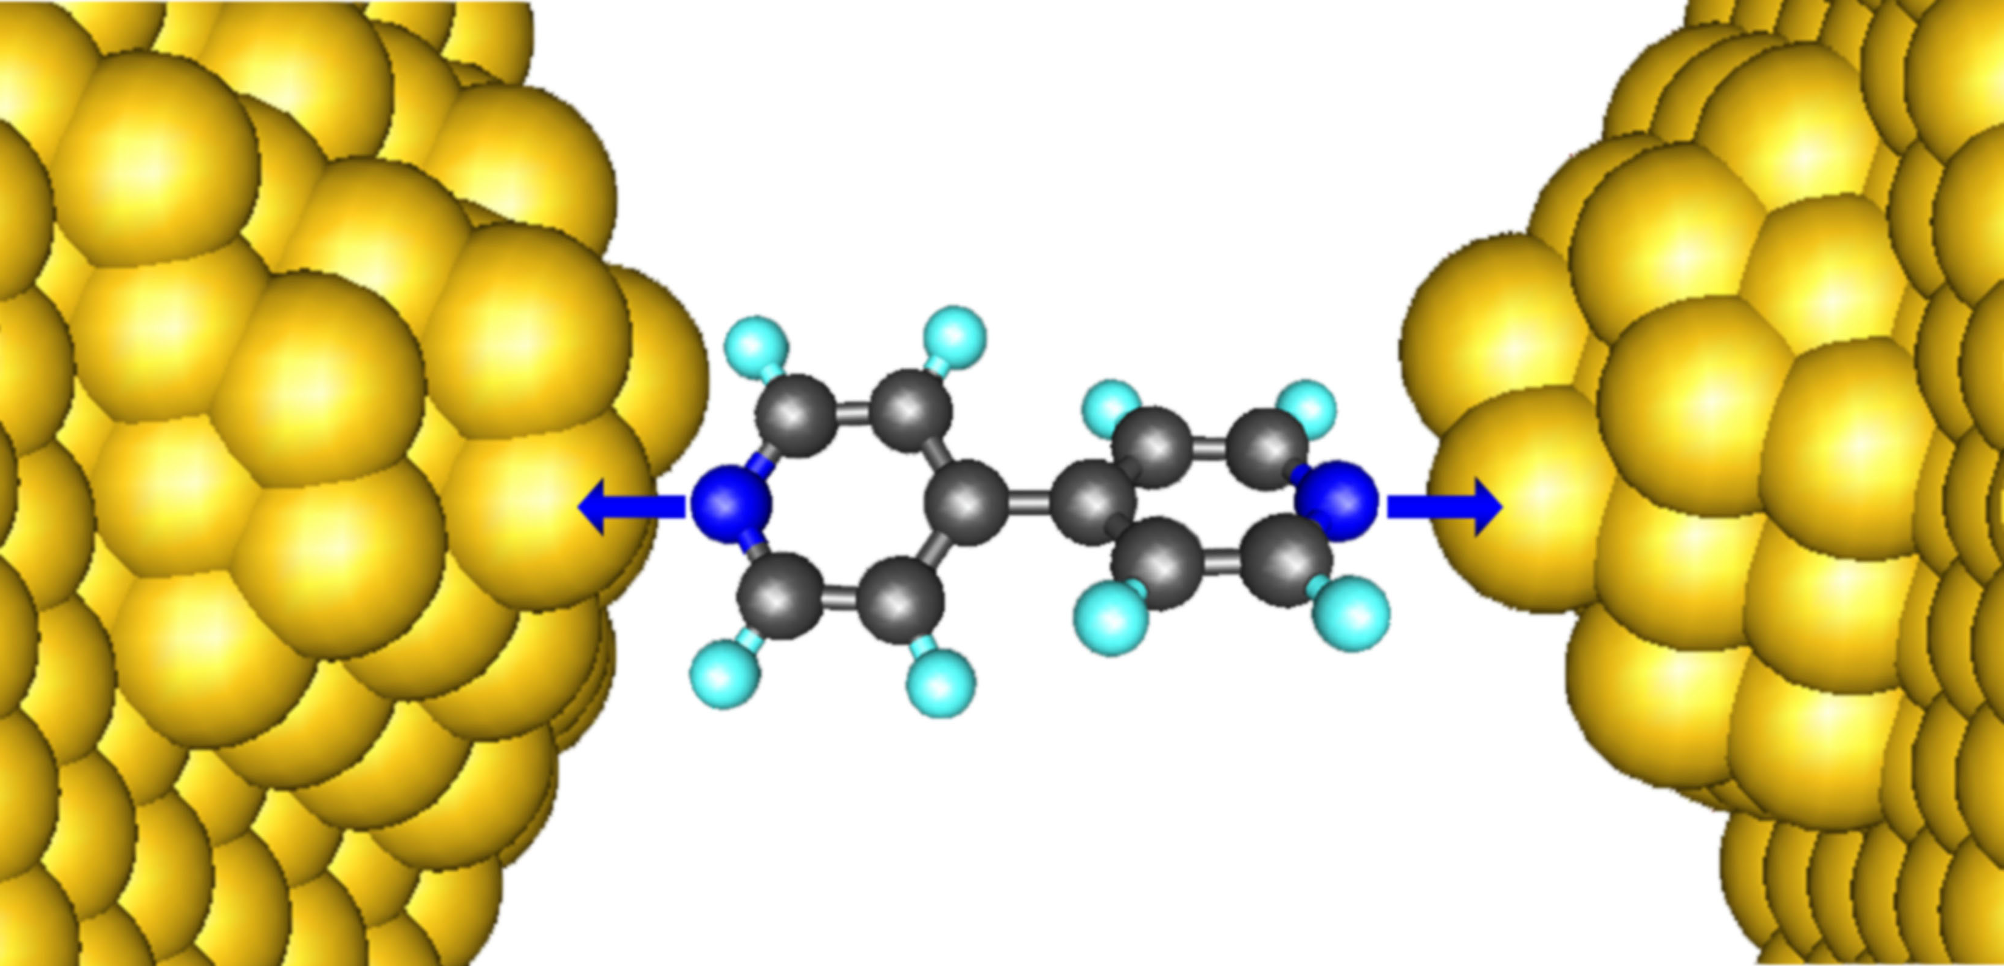
Quantum Embedding
Obtain accurate properties of a small subsystem without performing expensive calculation on the full system

Slide 6
Quantum Embedding
Obtain accurate properties of a small subsystem without performing expensive calculation on the full system

Slide 7
Quantum Embedding
Obtain accurate properties of a small subsystem without performing expensive calculation on the full system
How to account for effects of the surrounding environment?

Slide 8
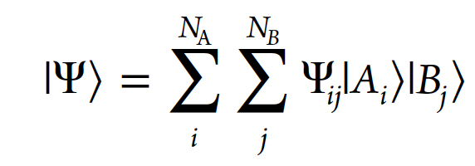
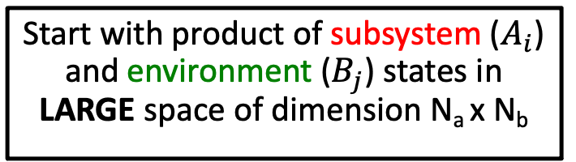
Density Matrix Embedding Theory
Surrounding environment treated as a quantum bath of the same size as the subsystem – Schmidt Decomposition
Schmidt decomposition:
Start with product of subsystem ($A_{i}$) and environment ($B_{j}$) states in LARGE space of dimension N_{a} x N_{b}

Slide 9
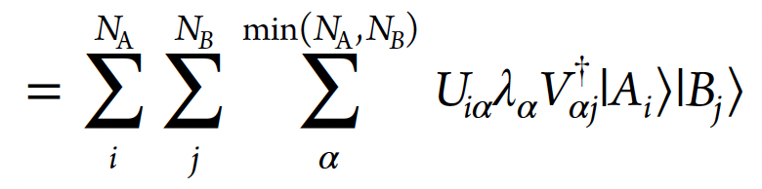
Density Matrix Embedding Theory
Surrounding environment treated as a quantum bath of the same size as the subsystem – Schmidt Decomposition
Schmidt decomposition:
Start with product of subsystem ($A_{i}$) and environment ($B_{j}$) states in LARGE space of dimension N_{a} x N_{b}

Slide 10
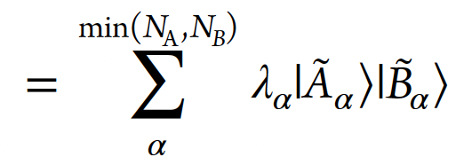
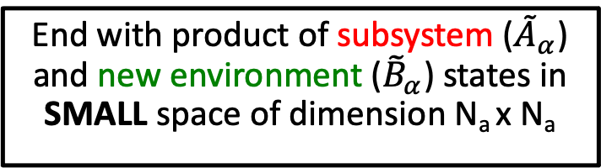
Density Matrix Embedding Theory
Surrounding environment treated as a quantum bath of the same size as the subsystem – Schmidt Decomposition
Schmidt decomposition:
Start with product of subsystem ($A_{i}$) and environment ($B_{j}$) states in LARGE space of dimension N_{a} x N_{b}
End with product of subsystem (${\tilde{A}}_{α}$) and new environment (${\tilde{B}}_{α}$) states in SMALL space of dimension N_{a} x N_{a}

Slide 11
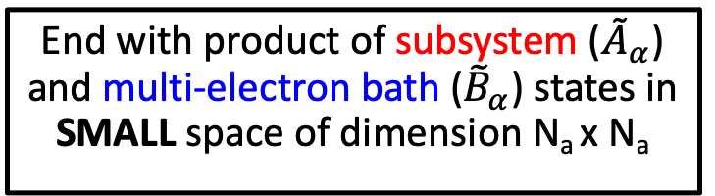
Density Matrix Embedding Theory
Surrounding environment treated as a quantum bath of the same size as the subsystem – Schmidt Decomposition
Schmidt decomposition:
Start with product of subsystem ($A_{i}$) and environment ($B_{j}$) states in LARGE space of dimension N_{a} x N_{b}
End with product of subsystem (${\tilde{A}}_{α}$) and multi-electron bath (${\tilde{B}}_{α}$) states in SMALL space of dimension N_{a} x N_{a}

Slide 12
Density Matrix Embedding Theory
Surrounding environment treated as a quantum bath of the same size as the subsystem – Schmidt Decomposition
Schmidt Decomposition
+
Start with product of subsystem ($A_{i}$) and environment ($B_{j}$) states in LARGE space of dimension N_{a} x N_{b}
End with product of subsystem (${\tilde{A}}_{α}$) and multi-electron bath (${\tilde{B}}_{α}$) states in SMALL space of dimension N_{a} x N_{a}

Slide 13
Density Matrix Embedding Theory
Surrounding environment treated as a quantum bath of the same size as the subsystem – Schmidt Decomposition
Schmidt Decomposition
+
The good: in principle have a method to exactly embed a fragment in a bath of the same size as the fragment itself

Slide 14
Density Matrix Embedding Theory
Surrounding environment treated as a quantum bath of the same size as the subsystem – Schmidt Decomposition
Schmidt Decomposition
+
The good: in principle have a method to exactly embed a fragment in a bath of the same size as the fragment itself
The bad: knowledge of the exact wavefunction is needed to construct the bath states

Slide 15
Density Matrix Embedding Theory
Surrounding environment treated as a quantum bath of the same size as the subsystem – Schmidt Decomposition
Schmidt Decomposition
+
The Fix – Static DMET:
Construct the bath states from mean-field wavefunction on the total system
Perform correlated calculation utilizing these bath states
Introduce self-consistency between mean-field wavefunction and correlated calculation – one-electron reduced density matrix

Slide 16
Real-Time DMET
Schmidt Decomposition
Approximate bath states
+

Slide 17
Real-Time DMET
Schmidt Decomposition
Approximate bath states
+
Initial formulation utilized time-dependent variational principle to derive equations of motion for embedding wavefunction
Equations of motion bare resemblance to time-dependent CAS

Slide 18
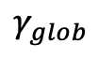
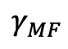
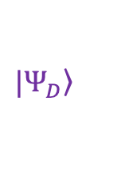
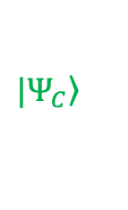
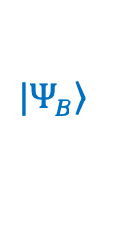
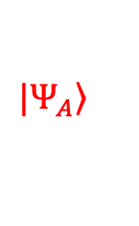
Multi-Fragment Extension
Mean-field
Correlated
$$γ_{MF}$$
+
$$\left.{|Ψ}_{A}\right\rangle$$
+
$$\left.{|Ψ}_{B}\right\rangle$$
$$γ_{glob}$$
+
$$\left.{|Ψ}_{C}\right\rangle$$
+
$$\left.{|Ψ}_{D}\right\rangle$$
Separate correlated embedding calculations all derived from same total-system mean-field calculation
“Stitch” together embedding calculations through democratic partitioning of operators
$$\left\langle {\hat{a}}_{i}^{† }{\hat{a}}_{j}+{\hat{a}}_{j}^{† }{\hat{a}}_{i}\right\rangle =\left\langle Ψ_{x\left(i\right)} | {\hat{a}}_{i}^{† }{\hat{a}}_{j} | Ψ_{x\left(i\right)}\right\rangle +\left\langle Ψ_{x\left(j\right)} | {\hat{a}}_{j}^{† }{\hat{a}}_{i} | Ψ_{x\left(j\right)}\right\rangle$$

Slide 19
Multi-Fragment Extension
Mean-field
Correlated
$$γ_{MF}$$
+
$$\left.{|Ψ}_{A}\right\rangle$$
+
$$\left.{|Ψ}_{B}\right\rangle$$
$$γ_{glob}$$
+
$$\left.{|Ψ}_{C}\right\rangle$$
+
$$\left.{|Ψ}_{D}\right\rangle$$
Difficulty for Dynamics:
Conventional DMET matching condition between mean-field and embedding calculations breaks down
TDVP does not allow for multiple fragments

Slide 20
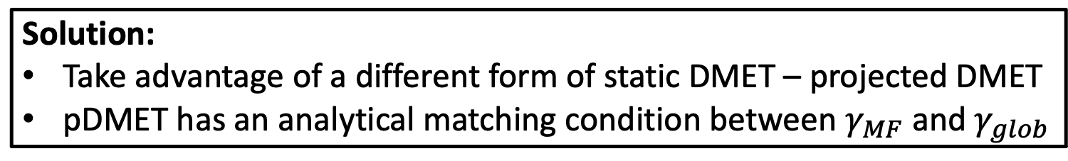
Multi-Fragment Extension
Mean-field
Correlated
$$γ_{MF}$$
+
$$\left.{|Ψ}_{A}\right\rangle$$
+
$$\left.{|Ψ}_{B}\right\rangle$$
$$γ_{glob}$$
+
$$\left.{|Ψ}_{C}\right\rangle$$
+
$$\left.{|Ψ}_{D}\right\rangle$$
Solution:
Take advantage of a different form of static DMET – projected DMET
pDMET has an analytical matching condition between $γ_{MF}$ and $γ_{glob}$
(Yehorova and Kretchmer, JCP 2023)

Slide 21
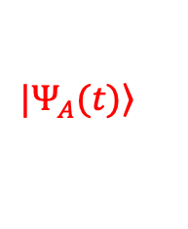
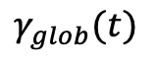
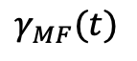
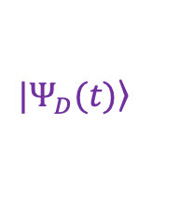
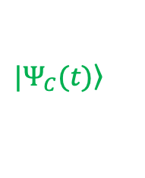
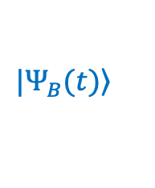
Real-Time pDMET
Mean-field
Correlated
$$γ_{MF}(t)$$
+
$$\left.{|Ψ}_{A}(t)\right\rangle$$
+
$$\left.{|Ψ}_{B}(t)\right\rangle$$
$$γ_{glob}(t)$$
+
$$\left.{|Ψ}_{C}(t)\right\rangle$$
+
$$\left.{|Ψ}_{D}(t)\right\rangle$$
General Idea: Simultaneously propagate mean-field wavefunction of full system and correlated wavefunction for each fragment and its bath, such that the pDMET conditions are met at each point in time
(Yehorova and Kretchmer, JCP 2023)

Slide 22
Real-Time pDMET
General Idea: Simultaneously propagate mean-field wavefunction of full system and correlated wavefunction for each fragment and its bath, such that the pDMET conditions are met at each point in time
(Yehorova and Kretchmer, JCP 2023)

Slide 23
Real-Time pDMET
General Idea: Simultaneously propagate mean-field wavefunction of full system and correlated wavefunction for each fragment and its bath, such that the pDMET conditions are met at each point in time
Condition 1: Bath for each fragment obtained from Schmidt decomposition of mean-field 1RDM
(Yehorova and Kretchmer, JCP 2023)

Slide 24
Real-Time pDMET
General Idea: Simultaneously propagate mean-field wavefunction of full system and correlated wavefunction for each fragment and its bath, such that the pDMET conditions are met at each point in time
Condition 1: Bath for each fragment obtained from Schmidt decomposition of mean-field 1RDM
Condition 2: Mean-field 1RDM obtained from natural orbitals of global 1RDM formed from all fragments
(Yehorova and Kretchmer, JCP 2023)

Slide 25
Real-Time pDMET
General Idea: Simultaneously propagate mean-field wavefunction of full system and correlated wavefunction for each fragment and its bath, such that the pDMET conditions are met at each point in time
Condition 1: Bath for each fragment obtained from Schmidt decomposition of mean-field 1RDM
Condition 2: Mean-field 1RDM obtained from natural orbitals of global 1RDM formed from all fragments
Time-dependence of DMET wavefunction for each fragment:
obtained from TDSE projected into the embedding space
obtained from pDMET conditions at each point in time
(Yehorova and Kretchmer, JCP 2023)

Slide 26
Real-Time pDMET
Mean-field
Correlated
$$γ_{MF}(t)$$
+
$$\left.{|Ψ}_{A}(t)\right\rangle$$
+
$$\left.{|Ψ}_{B}(t)\right\rangle$$
$$γ_{glob}(t)$$
+
$$\left.{|Ψ}_{C}(t)\right\rangle$$
+
$$\left.{|Ψ}_{D}(t)\right\rangle$$
Exact in non-interacting limit
Exact in large subsystem limit
Allows for correlation between subsystem and environment
Do not need to specify specific area of high accuracy
(Yehorova and Kretchmer, JCP 2023)

Slide 27
Single Impurity Anderson Model
U = 0
t
t
t
t
t
t
Time = 0
U > 0
Time > 0
t
t
t
t
t
t
N = 60
U = 2
U = 3
U = 4
Exact
TDHF
Electron density
(Yehorova and Kretchmer, JCP 2023)

Slide 28
Single Impurity Anderson Model
U = 0
t
t
t
t
t
t
Time = 0
U > 0
Time > 0
t
t
t
t
t
t
N = 60
U = 2
U = 3
U = 4
Exact
TDHF
Electron density
rt-pDMET:
Nsub = 2
(Yehorova and Kretchmer, JCP 2023)

Slide 29
Single Impurity Anderson Model
U = 0
t
t
t
t
t
t
Time = 0
U > 0
Time > 0
t
t
t
t
t
t
N = 60
U = 2
U = 3
U = 4
Exact
TDHF
Electron density
rt-pDMET:
Nsub = 2
Nsub = 4
(Yehorova and Kretchmer, JCP 2023)

Slide 30
Single Impurity Anderson Model
U = 0
t
t
t
t
t
t
Time = 0
U > 0
Time > 0
t
t
t
t
t
t
N = 60
U = 2
U = 3
U = 4
Exact
TDHF
Electron density
rt-pDMET:
Nsub = 2
Nsub = 4
Nsub = 5
Real-time pDMET converges to the exact answer even in the strongly correlated regime
(Yehorova and Kretchmer, JCP 2023)

Slide 31
Multi-Impurity Anderson Model
U = 0
U = 0
U = 0
t
t
t
t
t
t
Time = 0
U > 0
U > 0
U > 0
Time > 0
t
t
t
t
t
t
U = 3
N = 120
Exact
TDHF
Electron density
rt-pDMET:
Nsub = 5
(Yehorova and Kretchmer, JCP 2023)

Slide 32

Multi-Impurity Anderson Model
U = 0
U = 0
U = 0
t
t
t
t
t
t
Time = 0
U > 0
U > 0
U > 0
Time > 0
t
t
t
t
t
t
N = 120
U = 3
Exact
Electron density
TDHF
rt-pDMET:
Nsub = 5
(Yehorova and Kretchmer, JCP 2023)

Slide 33
Multi-Impurity Anderson Model
U = 0
U = 0
U = 0
t
t
t
t
t
t
Time = 0
U > 0
U > 0
U > 0
Time > 0
t
t
t
t
t
t
N = 120
U = 3
Exact
Electron density
TDHF
rt-pDMET:
Nsub = 5
Real-time pDMET accurately treats all regions of space even for a disordered system
(Yehorova and Kretchmer, JCP 2023)

Slide 34
Laser-Driven Electron Dynamics
Time = 0
Time > 0
Time-dependent density
Central site
t
t
t
t
Non-central within laser region
t
t
Exact
DMET
U = 0
U > 0
TDHF
t
t
Non-central outside laser region
t
t
t
t
(Yehorova and Kretchmer, JCP 2023)

Slide 35
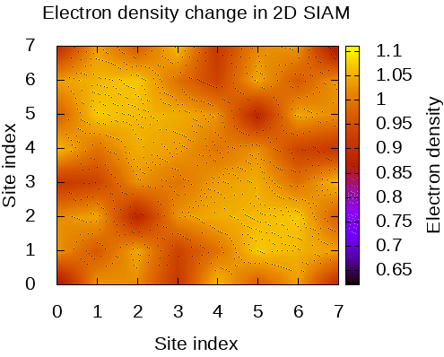
Multi-dimensional Impurity Model
(Yehorova and Kretchmer, JCP 2023)

Slide 36

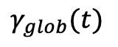
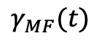
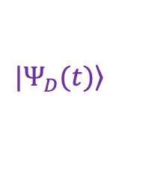
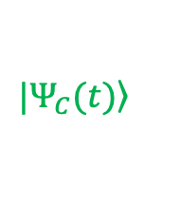
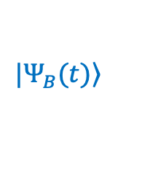
Conclusions
Mean-field
Correlated
$$γ_{MF}(t)$$
+
$$\left.{|Ψ}_{A}(t)\right\rangle$$
+
$$\left.{|Ψ}_{B}(t)\right\rangle$$
$$γ_{glob}(t)$$
+
$$\left.{|Ψ}_{C}(t)\right\rangle$$
+
$$\left.{|Ψ}_{D}(t)\right\rangle$$
Real-time projected density matrix embedding theory
Multi-fragment real-time quantum embedding method
Non-equilibrium electron dynamics in strongly correlated systems
Accurately treat dynamics across entire system
(Yehorova and Kretchmer, JCP 2023)

Slide 37
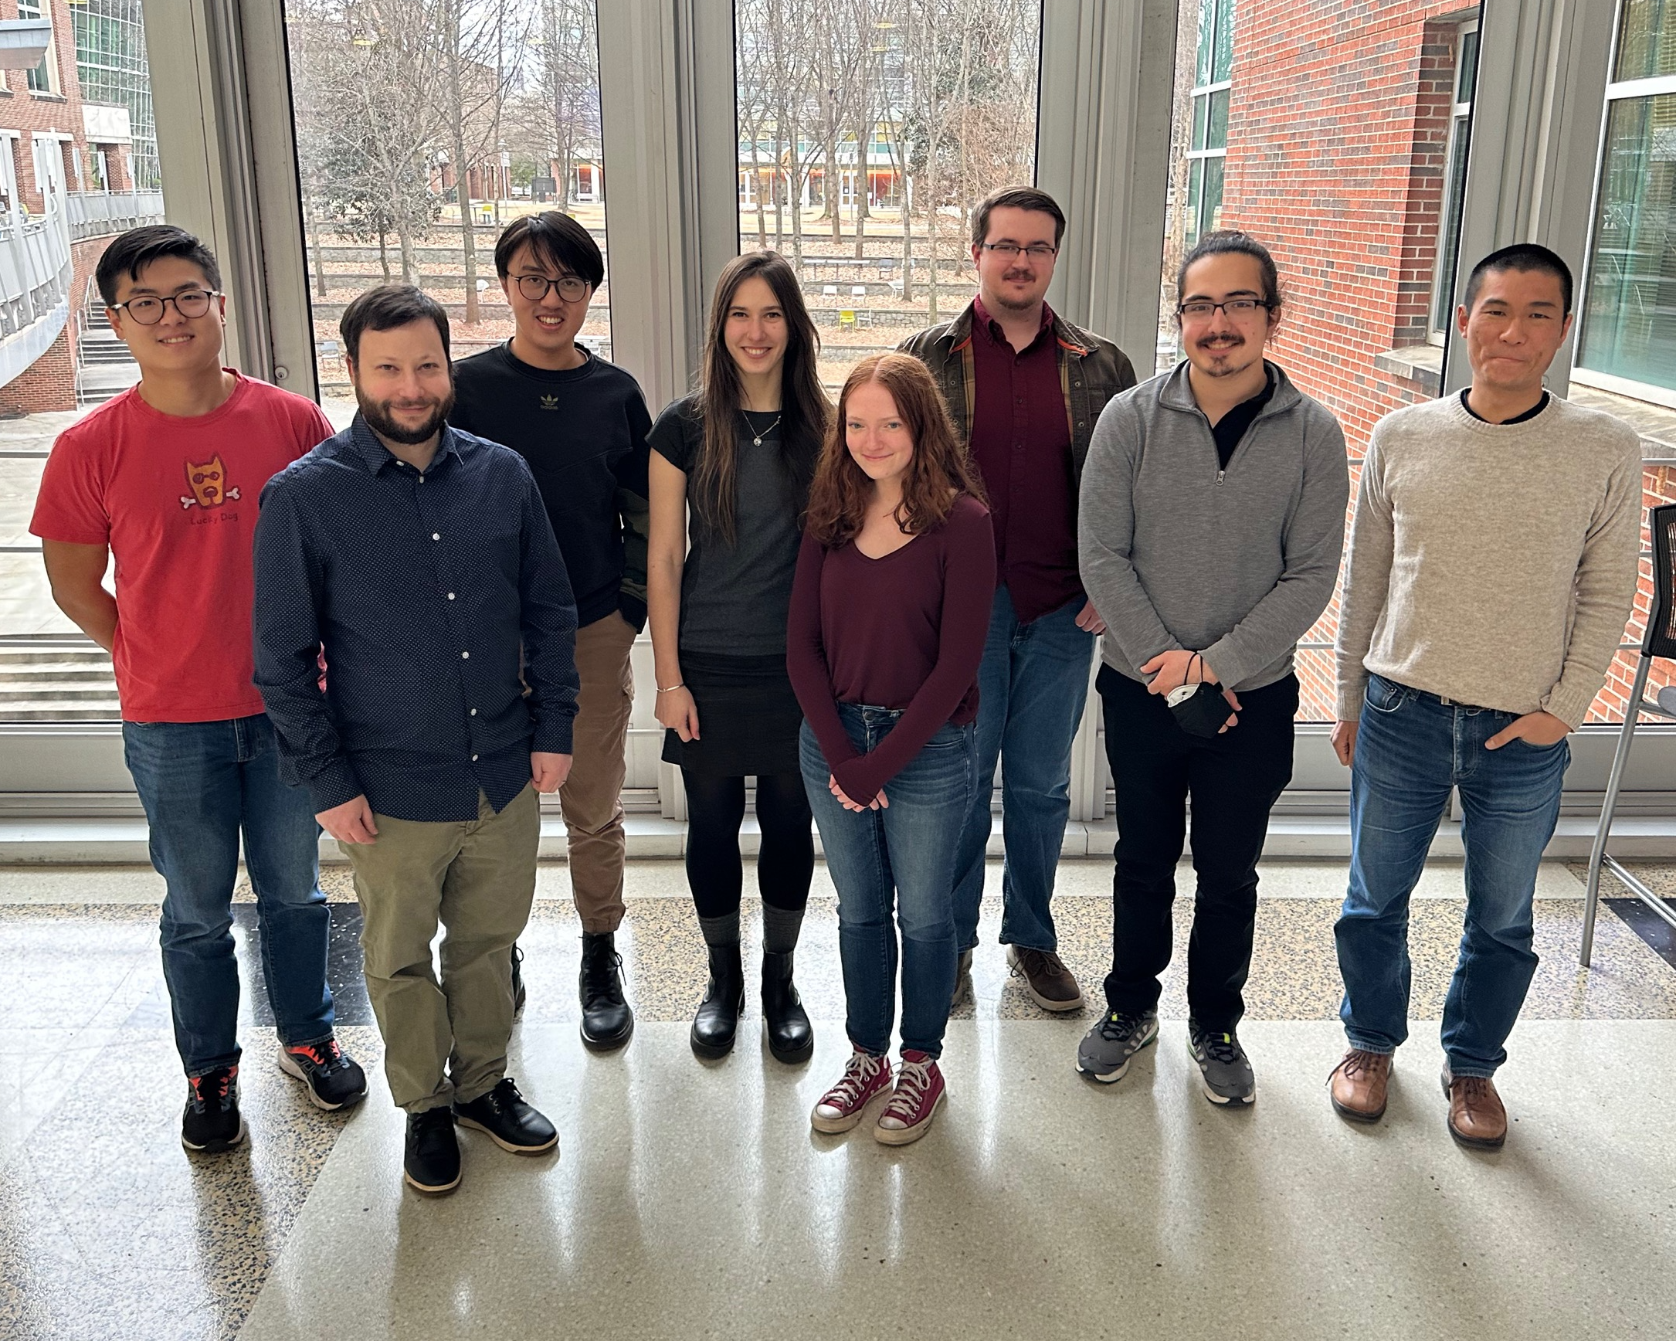
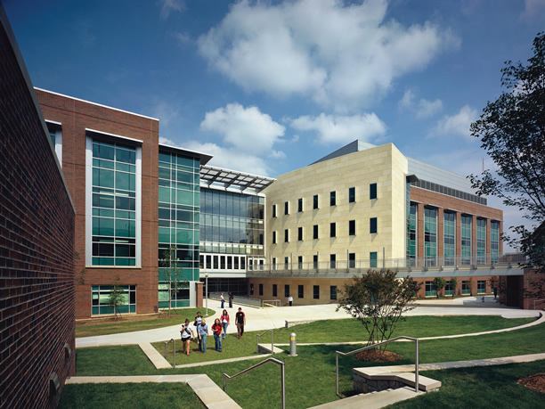

Acknowledgements
Yi-Siang Wang
Ziying Cao
Dariia Yehorova
James Zhong
Jordan Hale
Mikhayla Clothier
Victor Suarez
Computing: PACE at Georgia Tech, NERSC

